Slide 1
Neural correlates to movements from Q1
GitHub\LID_Ketamine_String_Pulling\Questions_stephen\String_Pulling

Slide 2
To Do.
Make sure the data is loading in correctly from Gia.

Slide 3
Next Steps
LEFT OFF WITH Q1_Do_neurons_correlate_with_string_pulling_ensemble which calculates the single unit data – how much info between single neurons and the movement parameters.
Regression, ‘place field’,
PROBLEMS: this is continuous data so one single trial where the firing rate happens to be increasing and rat moves up will definitely produce a correlation. As a result 1) it would be good to break into trials or pulls.
WAIT: I though I did this – I am able to get individual pull bout from the speed of the rotary encoder. IF I do this, I can add caonstraints like the neuron had to fire on > 30% of trials or something.
Determine if there is information in the neural ensemble about the movement coordinates.
Determine if single-units correlate to aspects of string pulling. Big question: What are those aspects?
A preference for the left or right arm (e.g. first derivative of arm's vertical movement). An asymmetry?
String speed
Arm speed
First derivative of vertical movement (so that up and opposite of down).
Phases of the pull: Grab vs. release vs. upward reach. (How do we calculate this?)
Absolute arm coordinates v.s. coordinates relative to the nose?
Nose position and movement.
Rotating treadmill and speed.
What others?

Slide 4
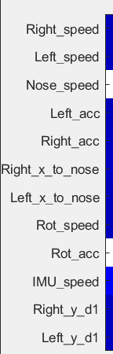
Neural ensemble measures of encoding motion data in motor cortex.
What features does the population as a whole respond to? (This is not a single-neuron analysis)
Approach: (Q1_Do_neurons_correlate_with_string_pulling_ensemble.m)
Create neural ensemble matrix binned at 5ms (time x # neurons)
Map this matrix to the motion data (150Hz resolution): see right.
Systematically apply a smoothing factor to this matrix from no smoothing to 2 seconds of smoothing with a half-hamming kernel. Used a half-hamming as I did not want to smear neural activity into the past as that would falsely suggest that neurons were predictive of the future.
For each smooth window, compute the principal component dimensions. Limit to the top 4 dimensions. Use these dimensions and send to a multiple regression model that attempt to predict each of the outcome variables on the right from these data.
Model = Y_motion ~ PC_components
Do the same but after randomly shuffling the time bins for each neuron in the neuron x time matrix (as a control)
Subtract the shuffle Rsq from the actual Rsq and only include Rsq values that were significant.

Slide 5
Example of a neural ensemble matrix and motion data…
Example of the r squared values for different motion parameters at different smoothing factors.
msec

Slide 6
All Data
White indicates not significant or < 0.001
Color indicates Rsq-Rsq_shuff
X axis = msec

Slide 7
Interesting examples
I found these to be interesting as there was a peak in the Rsq at the left x to nose. This suggests that there were individual neurons in these sets that responded to the position of the paw relative to the nose.
Both also show responses to the acceleration of the right paw but only at large window sizes suggesting that this is not to fast changes in acceleration but slow changes in acceleration.
The above suggests that the time-scale matters.
Both also respond well to the rotation speed (which is the speed of the string) and that this positively correlates to the IMU speed.
Interesting negative findings: I thought that the first derivative of paw position in the y direction would show something as this would indicate reaching up (positive first derivative) or pulling down (negative first derivative).
msec

Slide 8
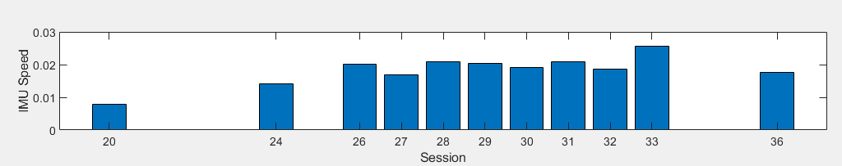
Right: mean IMU speed as function of session.
We need a measure of the quality of a pulling session so that we can eliminate bad sessions where he did not pull well or the motion data was not captured well.

Slide 9
Single Unit Responses

Slide 10
Where I left off
Q1_Do… single_unit.m
Found a few gorgeous single unit responses but really in Rat315 session 31 so far. Not so great in other sets.
OK in 27
GREat in 31
Notes:
PETH_raster_array(TS_uS,EVENTS.Left_start_up_t_uS, 4, PETH_win_ms, PETH_win_ms,3)

Slide 11
1
1
0
0

Slide 12

More characterizing behavior

Slide 13
Q1_Do_neurons_correlate_with_string_pulling_single_unit
Looking at one of the Wallace papers, they mentioned that they characterized the density of the reach angle for each paw. That was a great idea. I looked at the radial angles of the pulse up and pulls down for the automatically detected pull periods.
The up and down pulls seem to come out nicely. They should to a degree because detection requires that there is a positive (or negative) distance traveled in y (say 5 pixels). In any case, there do seem to be some good data here and it will probably be a great way to distinguish the left from the right paw.
We can also look at the dispersion.

Slide 14
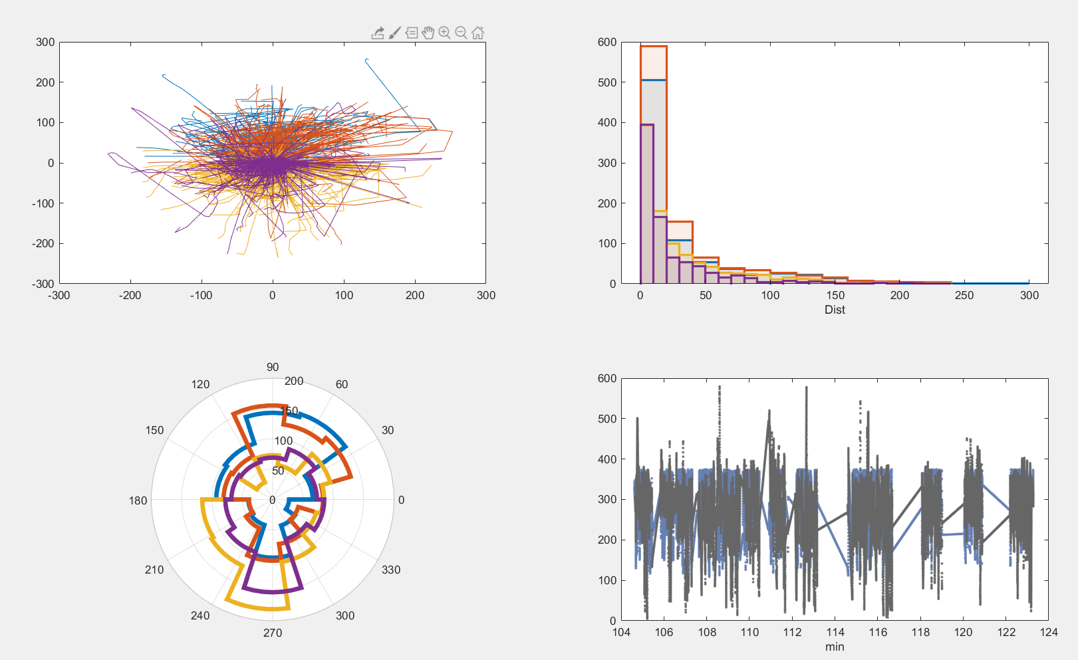
Problem: Trajectories do not look great – too much interpolation and straight lines.
Day 31
You see a lot of straight lines – this needs to be figured out. These should be somewhat smooth trajectories.
Q1
Q1_Do_neurons_correlate_with_string_pulling_single_unit

Slide 16
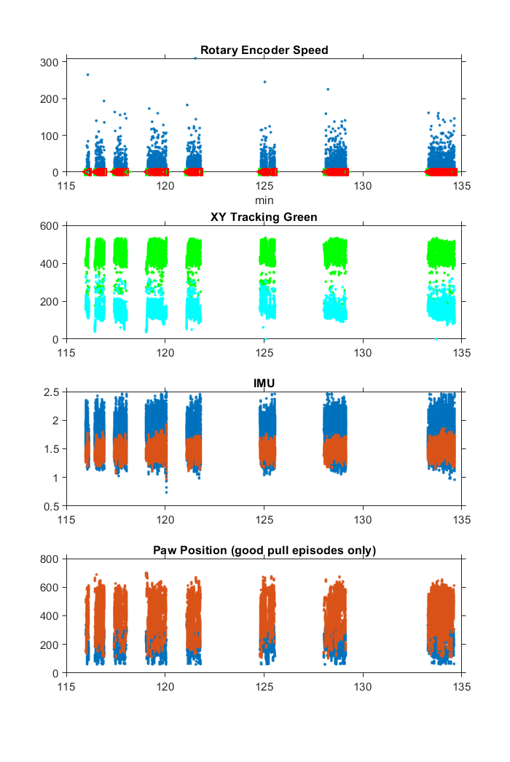

Slide 18
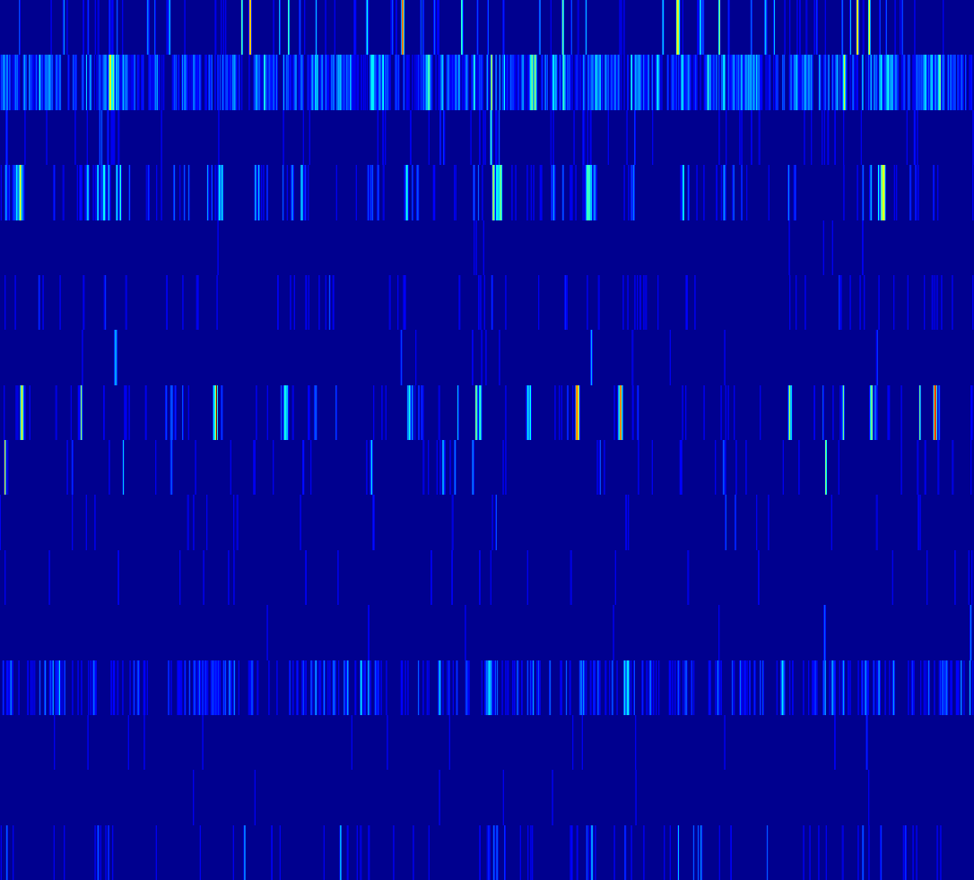
Bout 8
2
4
6
n
o
8
r
u
e
N
10
12
14
16
IMU
133.4
133.6
133.8
134
134.2
134.4
134.6
Rt
Lt
IMU and Paw
0.025
2.4
d
1
2.2
0.02
e
c
2
e
p
0.015
p
U
1.8
S
M
1.6
0.01
w
I
a
1.4
0.005
P
1.2
133.4
133.6
133.8
134
134.2
134.4
134.6
150
Rot Encoder
d
p
S
100
c
n
E
.
t
50
o
R
133.4
133.6
133.8
134
134.2
134.4
134.6
Minutes

Slide 22
PETH: Move Onset nrn 1
450
400
350
300
250
200
150
100
50
-200
-150
-100
-50
0
50
100
150
200
s
t
30
n
u
o
20
C
10
0
-200
-150
-100
-50
0
50
100
150
200
Time (msec)

